Slide 1
Getting started with Simulink
An introductory tutorial
by
SHRAVANKUMAR P

Slide 2
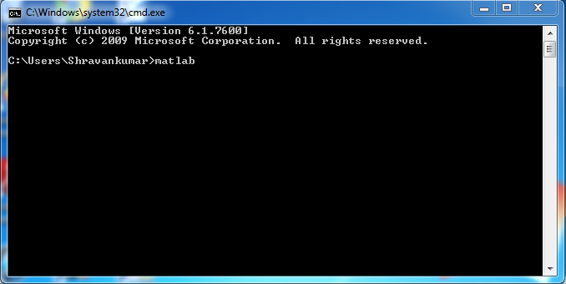
Launch Matlab
Open command prompt
>> matlab  enter

Slide 3
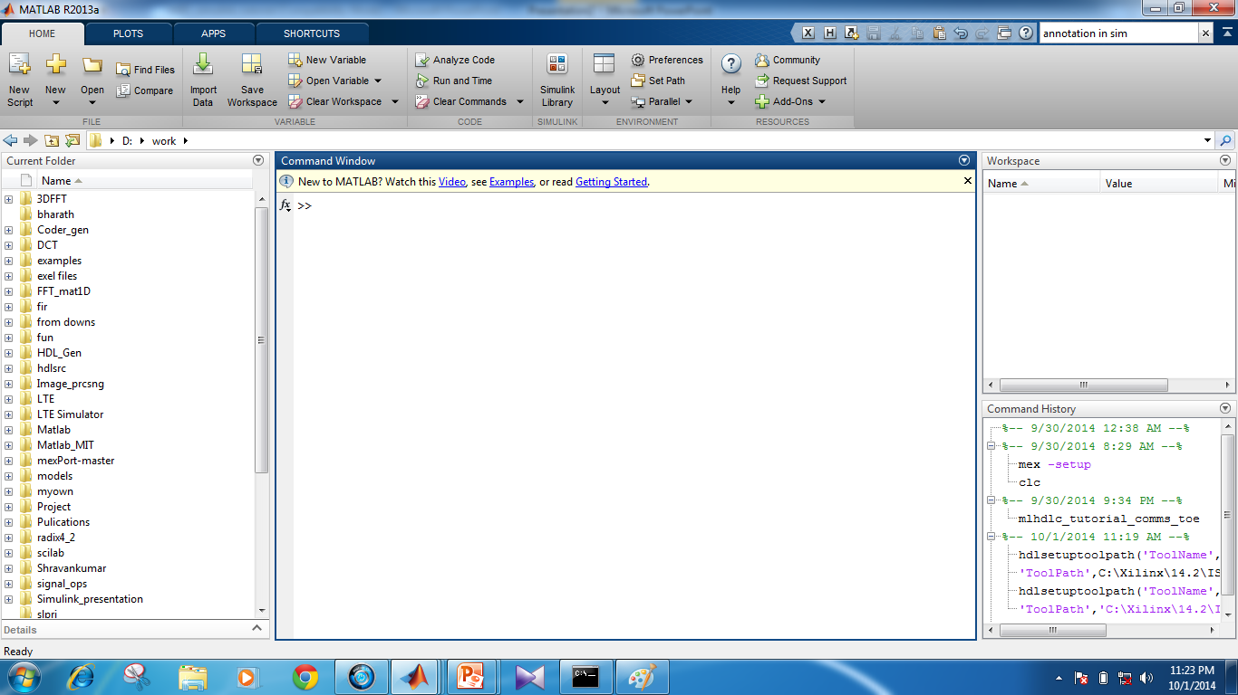
Matlab main window
workspace
Command window
Current Folder
Command
History

Slide 4
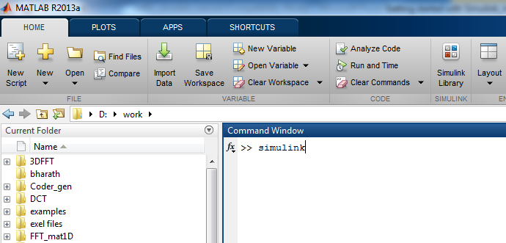
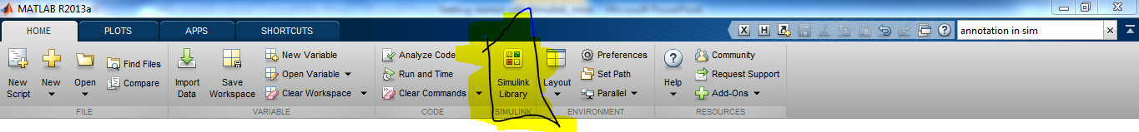
Launch Simulink
In the MATLAB command window,
at the >> prompt, type simulink
and press  Enter
or

Slide 5
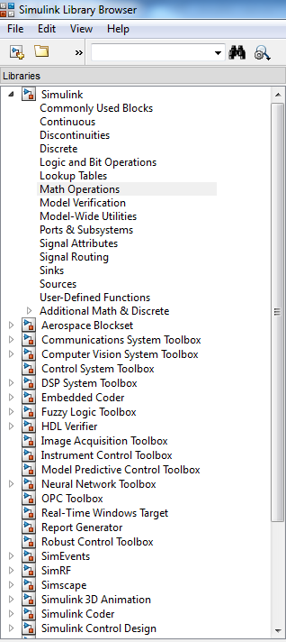
Create a new model
Click the new-model icon in the upper left corner to start a new Simulink file
Select the Simulink icon to obtain elements of the model

Slide 6
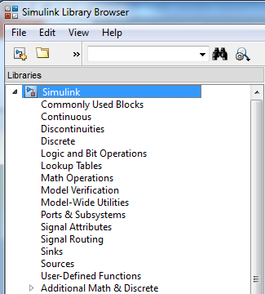
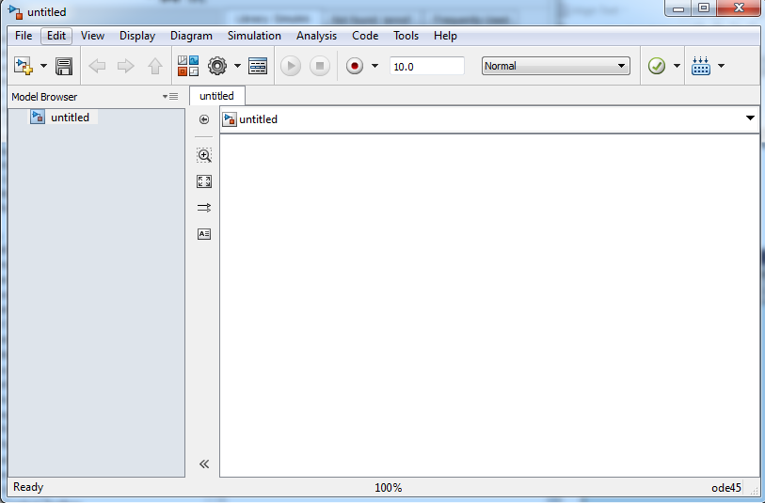
Your workspace
Library of elements Model is created in this window

Slide 7
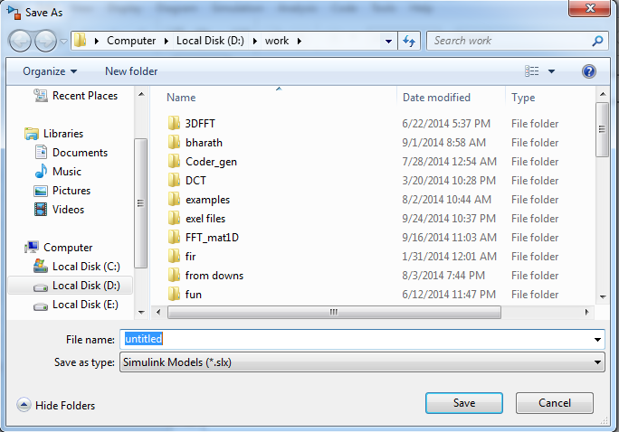
Save your model
Name your model

Slide 8
Example 1: a simple model
Build a Simulink model that solves the differential equation
Initial condition
First, sketch a simulation diagram of this mathematical model (equation)
(3 min.)

Slide 9
Simulation diagram
Input is the forcing function 3sin(2t)
Output is the solution of the differential equation x(t)
Now build this model in Simulink
x(t)
(output)
3sin(2t)
(input)
integrator

Slide 10
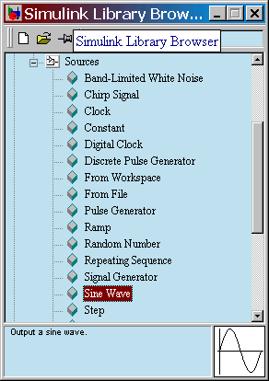
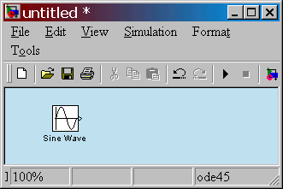
Select an input block
Drag a Sine Wave block from the Sources library to the model window

Slide 11
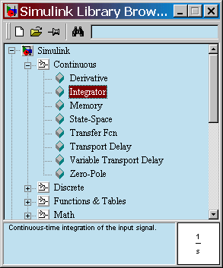
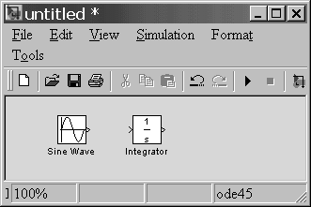
Select an operator block
Drag an Integrator block from the Continuous library to the model window

Slide 12
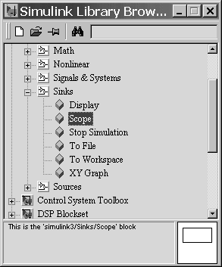
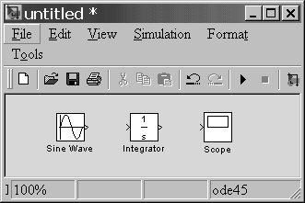
Select an output block
Drag a Scope block from the Sinks library to the model window

Slide 13
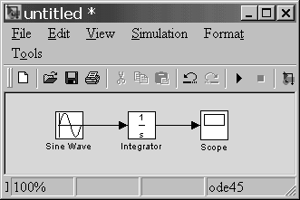
Connect blocks with signals
Place your cursor on the output port (>) of the Sine Wave block
Drag from the Sine Wave output to the Integrator input
Drag from the Integrator output to the Scope input
Arrows indicate the direction of the signal flow.

Slide 14
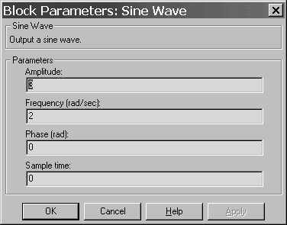
Select simulation parameters
Double-click on the Sine Wave block to set amplitude = 3
and freq = 2.
This produces the desired input of 3sin(2t)

Slide 15
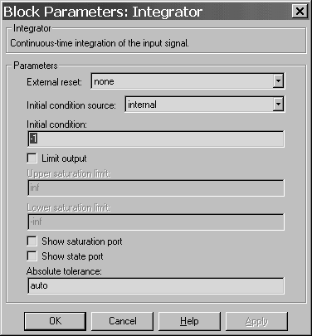
Select simulation parameters
Double-click on the Integrator block to set initial condition = -1.
This sets our IC x(0) = -1.

Slide 16
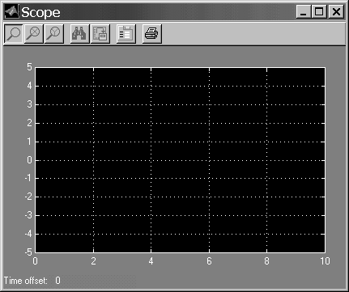
Select simulation parameters
Double-click on the Scope to view the simulation results

Slide 17
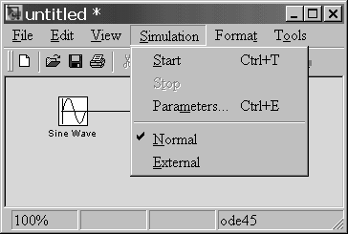
Run the simulation
In the model window, from the Simulation pull-down menu, select Start
View the output x(t) in the Scope window.

Slide 18
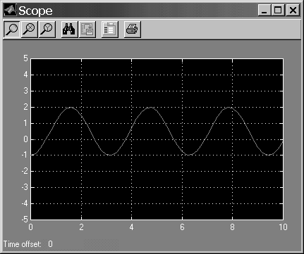
Simulation results
To verify that this plot represents the solution to the problem, solve the equation analytically.
The analytical result,
matches the plot (the simulation result) exactly.

Slide 19
Example 2
Build a Simulink model that solves the following differential equation
2nd-order mass-spring-damper system
zero ICs
input f(t) is a step with magnitude 3
parameters: m = 0.25, c = 0.5, k = 1

Slide 20
Create the simulation diagram
On the following slides:
The simulation diagram for solving the ODE is created step by step.
After each step, elements are added to the Simulink model.
Optional exercise: first, sketch the complete diagram (5 min.)

Slide 21
(continue)
First, solve for the term with highest-order derivative
Make the left-hand side of this equation the output of a summing block
summing block

Slide 22
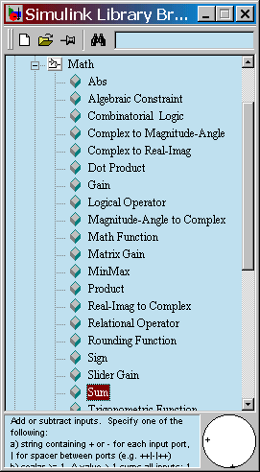
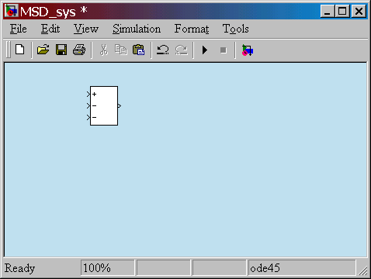
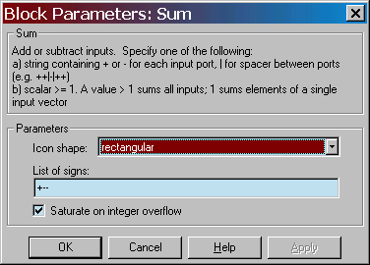
Drag a Sum block from the Math library
Double-click to change the block parameters to rectangular and + - -

Slide 23
(continue)
Add a gain (multiplier) block to eliminate the coefficient and produce the highest-derivative alone
summing block

Slide 24
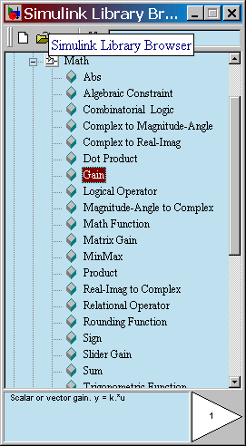
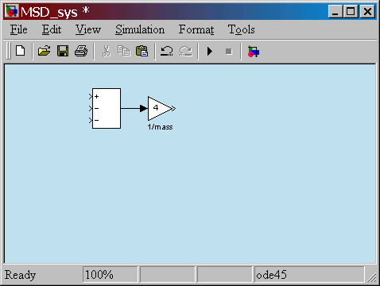
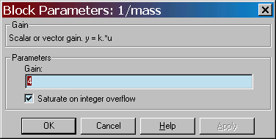
Drag a Gain block from the Math library
The gain is 4 since 1/m=4.
Double-click to change the block parameters.
Add a title.

Slide 25
(continue)
Add integrators to obtain the desired output variable
summing block

Slide 26
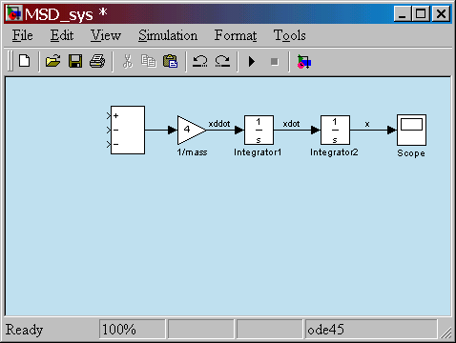
Drag Integrator blocks from the Continuous library
ICs on the integrators are zero.
Add a scope from the Sinks library.
Connect output ports to input ports.
Label the signals by double-clicking on the leader line.

Slide 27
(continue)
Connect to the integrated signals with gain blocks to create the terms on the right-hand side of the EOM
summing block
c
k

Slide 28
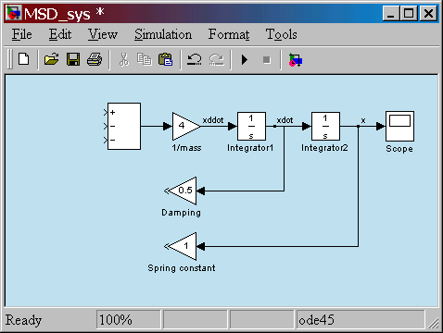
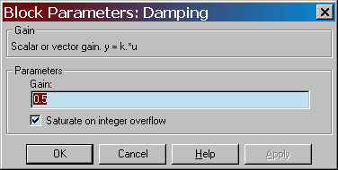
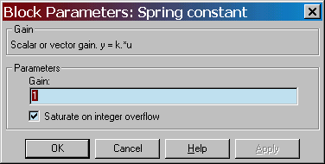
Drag new Gain blocks from the Math library
To flip the gain block, select it and choose Flip Block in the Format pull-down menu.
c=0.5
Double-click on gain blocks to set parameters
Connect from the gain block input backwards up to the branch point.
Re-title the gain blocks.
k=1.0

Slide 29
Complete the model
Bring all the signals and inputs to the summing block.
Check signs on the summer.
f(t)
input
+
-
x(t)
output
-
c
k

Slide 30
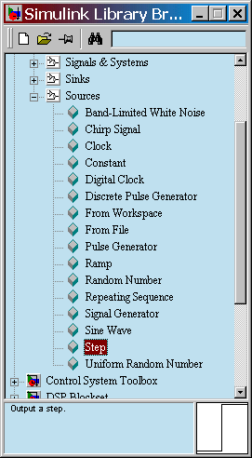
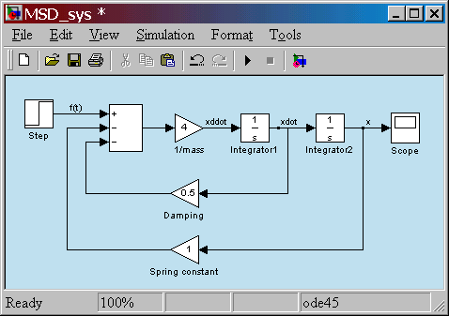
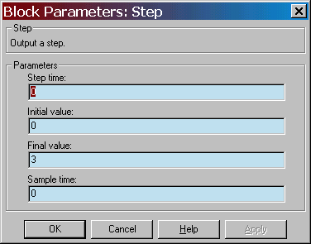
Double-click on Step block to set parameters. For a step input of magnitude 3, set Final value to 3

Slide 31
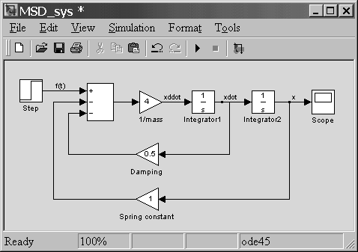
Final Simulink model

Slide 32
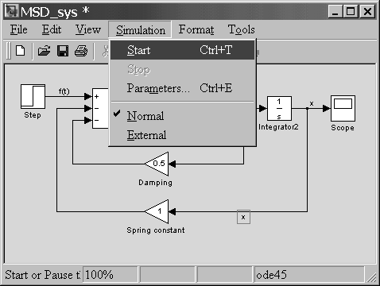
Run the simulation

Slide 33
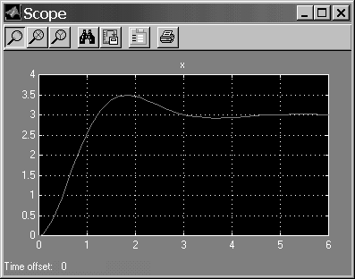
Results
Underdamped response.
Overshoot of 0.5.
Final value of 3.
Is this expected?

Slide 34
Paper-and-pencil analysis based on the equations of motion
Standard form
Nat’l freq.
Damping ratio
Static gain

Slide 35
Check simulation results
Damping ratio of 0.5 is less than 1.
Expect the system to be underdamped.
Expect to see overshoot.
Static gain is 1.
Expect output magnitude to equal input magnitude.
Input has magnitude 3, so does output.
Simulation results conform to expectations.

Slide 36
End of tutorial

